Slide 1


COMP3411 13A WK1
KELVIN YANG

Slide 2

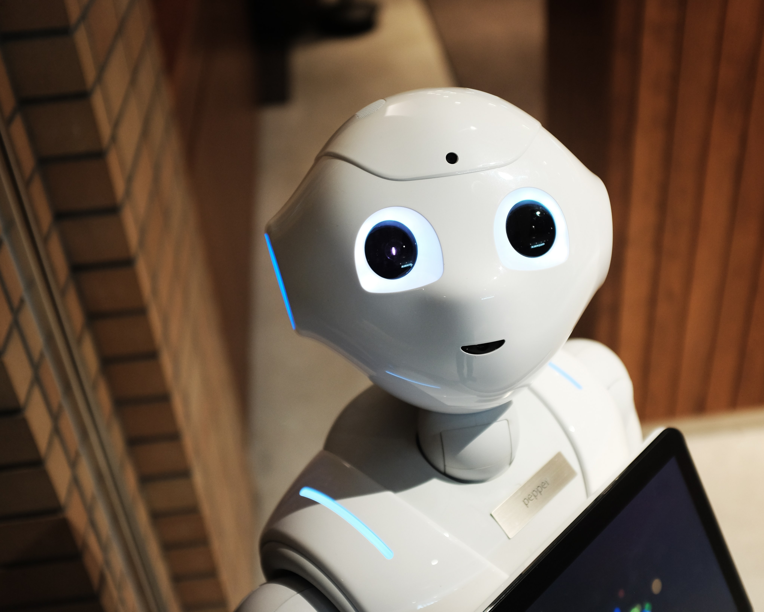
The course
COMP3411 AI
Broad Introduction to the different areas of AI
Many directions to go from here!
ML/DL: COMP9444, COMP9417
Databases
Big Data
Data Warehousing
Etc!
Tutorial materials:
https://www.openlearning.com/unswcourses/courses/comp3411-9814-21t0/tutorial-tasks-and-agents/?cl=1
https://www.openlearning.com/unswcourses/courses/comp3411-9814-21t0/tutorial_tbd/?cl=1

Slide 3

Contact Info
Kelvin Yang
Email: z5125244@unsw.edu.au
5th year Comp/Stats, Honours this year
Interest in machine learning, big data, and database
Would love to chat about future/career/more courses/and many more!
Shameless plug: please check out my AI blog post here

Slide 4


Your Turn!
Your name
Degree(s)
What in AI interests you?
Goals?

Slide 5
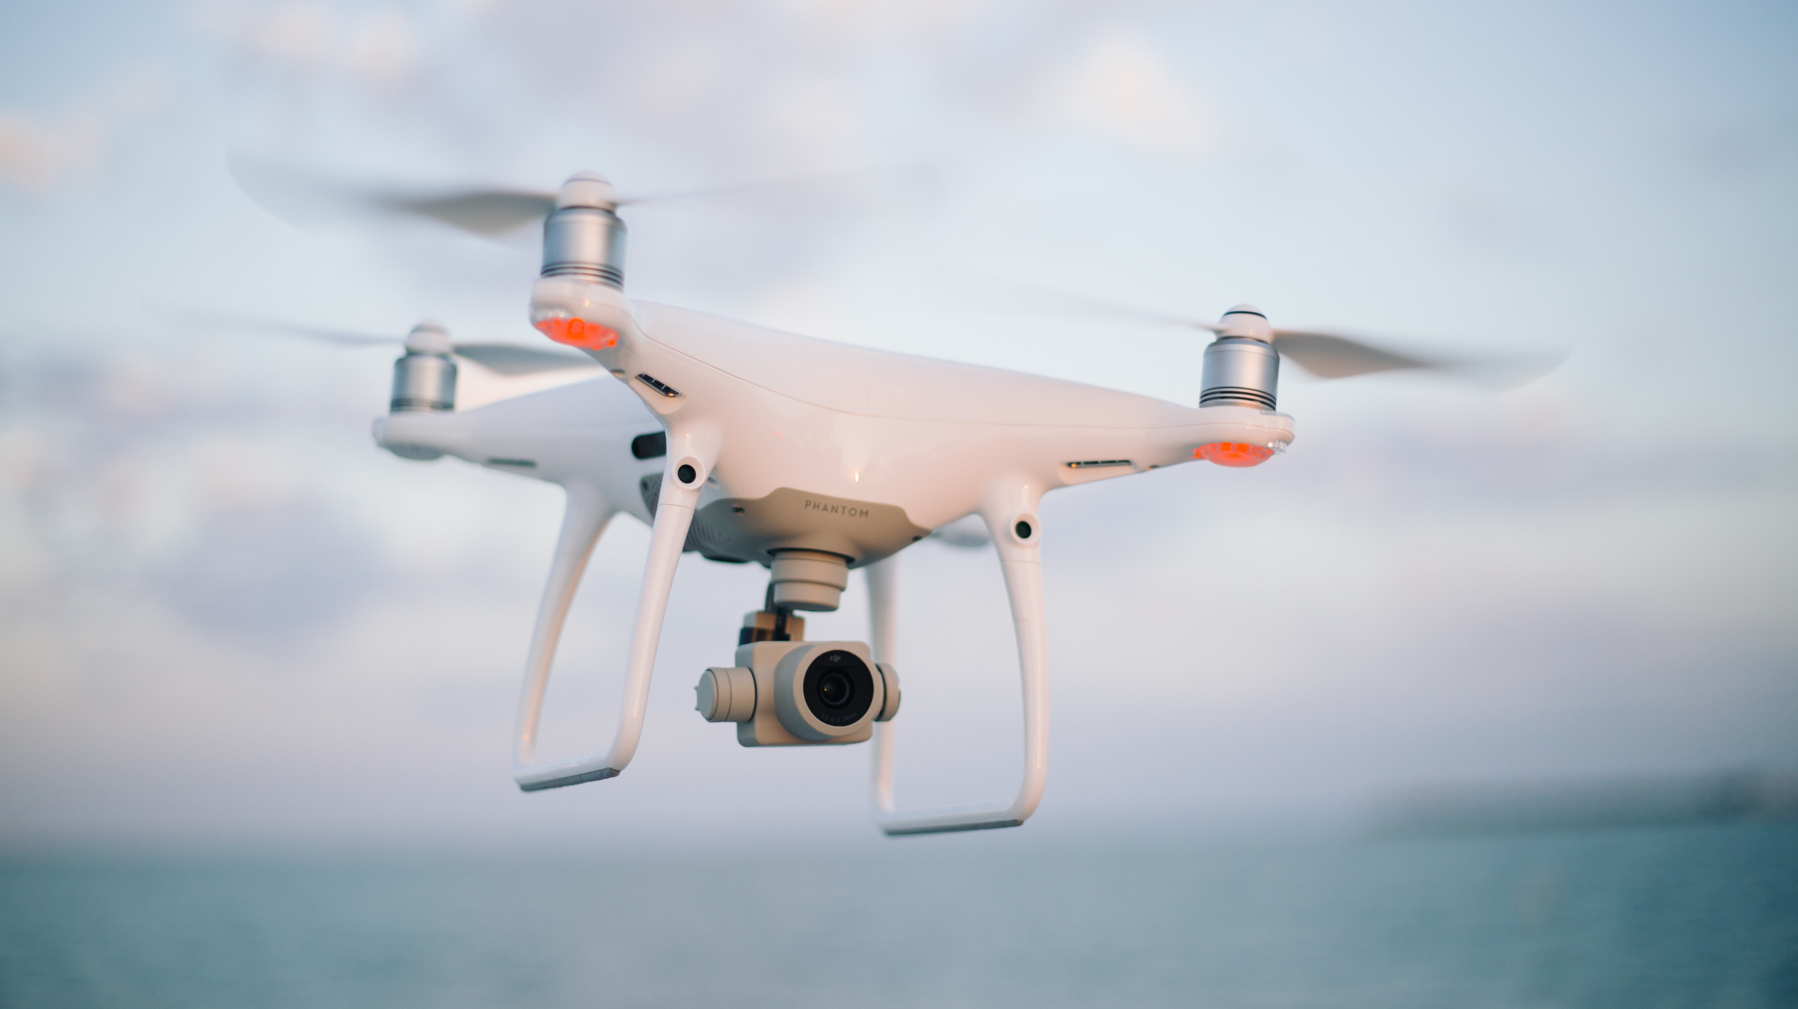
State of the Art
AI playing Ping Pong
7-11 food delivery drone
And many more!

Slide 6
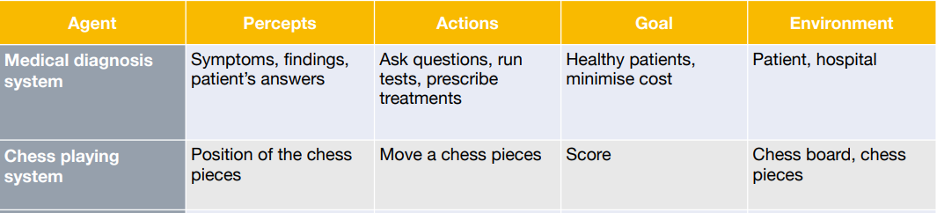
PAGE description
A clear, systematic framework to describe what an AI agent does
For example, (from lecture)

Slide 7
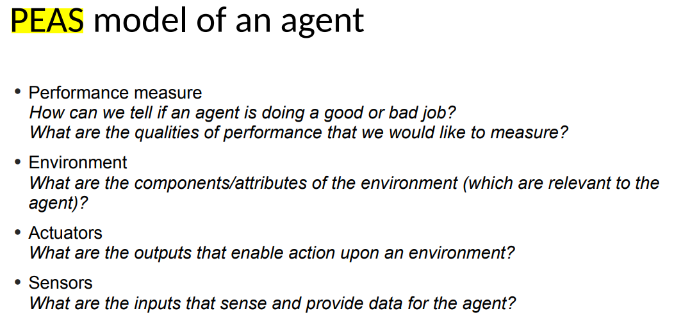
PEAS
A clear summary description of the task environment an agents operates under to facilitate the design of rational agent
From lecture again

Slide 8
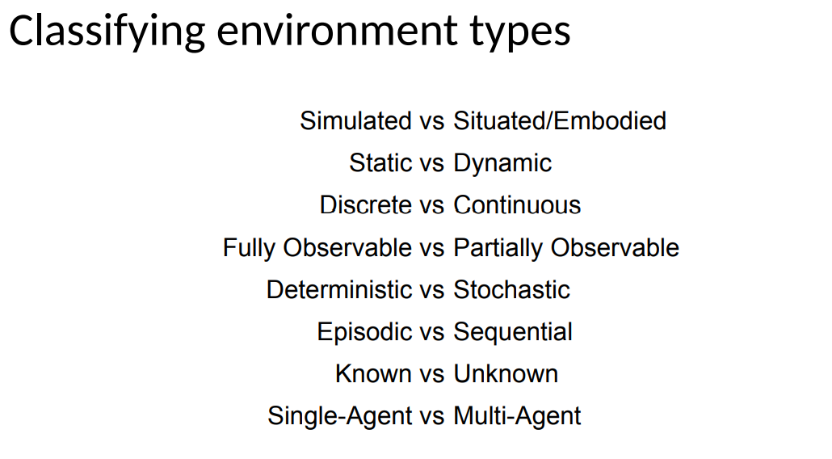
Environment Types
What are the characteristics of the type of environment the agent operates in?
Knowing this allows us to design more effective agents
Here is the lecture slide again

Slide 9
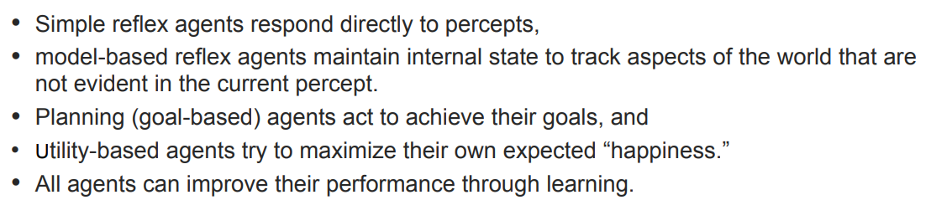
Agent Types
A summary is here
I will cite Anna as the co-author of this slide deck XD

Slide 10

Questions/Feedback/Reminder
Any questions?
Any feedback?
Don’t forget to do your homework!
Details in the announcement
Make MS form with 1 question each for part 1 and part 2 (2 questions in total), no part 3! Share the link with me (can send it to my email in first slide)
Post these questions to open learning

